Slide 1

Rollbaccine: the rollback vaccine
davidchuyaya/disk-tees (github.com)
David’s mid-internship presentation
8/23/2023

Slide 2
Outline
The threat model: Rollbacks
Existing work
Our approach
Evaluation

Slide 3

What is guaranTEEd?
🫖
👿
CFT
TEE
BFT
✔ CPU
✔ Memory
✔ Disk
✔ CPU
✔ Memory
✖ Disk
✖ CPU
✖ Memory
✖ Disk

Slide 4



🫖
Write hello.txt
Read hello.txt
📟
TEE
✔ CPU
✔ Memory
✖ Disk
💿
✍️
Read ???.txt or
Read oldHello.txt

Slide 5
We cannot trust the disk to persist
How do we solve this for general applications?

Slide 6
What do others do?
ROTE
Engraft
Narrator
USENIX Security ‘17
Increment a counter 🧮 on each write
Store it on disk 💿 and sign ✍️
Sync counter with quorum of TEEs 🫖
Verify on read
CCS ‘22
Change metadata 📊 on each write
Store data on disk 💿
Sync metadata with quorum of TEEs 🫖
Verify on read
CCS ‘22
Store inputs ⌨️ with quorum of TEEs 🫖
TEEs are also state machines
Query TEEs for reads
Replay inputs on restart
Treaty
Nimble
DSN ‘22
Transactional KV-store
Store data on disk 💿
Built on Speicher, which uses SGX counters 🧮
OSDI ‘23
Store tail of ledger🧾 with quorum of TEEs 🫖
Verify on read

Slide 7
Themes
Persistence?
Quorum of TEEs 🫖
ROTE
Engraft
Narrator
Nimble
SGX hardware 🛠️ counter
Treaty
Generalizing without “signing ✍️ all state”?
Not general
Engraft
Treaty
Sign all state ✍️
ROTE
Replicate inputs ⌨️
Narrator
Replicate log 🧾
Nimble

Slide 8
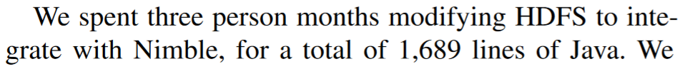





Themes
🐌
Persistence?
Quorum of TEEs 🫖
Generalizing without “signing ✍️ all state”?
Sign all state ✍️
ROTE
Replicate inputs ⌨️
Narrator
Replicate log 🧾
Nimble
Assumes inputs << state
Assumes determinism
Assumes log abstraction
We don’t like them 😒

Slide 9

Can we achieve the dream?
Rollback-proof
No assumptions, works with any application
0 lines of code modified, automatic
Cheap & fast

Slide 10
Key insights
🫖
If you can’t trust disk, trust memory 🧠
All applications interact with the disk through the file system 📂
The file system has APIs that explicitly guarantee persistence: fsync 🔄
TEE
✔ CPU
✔ Memory
✖ Disk

Slide 11
Key insights
Store the file system 📂 in memory 🧠 with virtual paging
Intercept writes and replicate across TEEs 🫖 for persistence
Reach consensus on fsync 🔄

Slide 12



Original execution
📟
Write, read, fsync
💿
Postgres🛢️

Slide 13






Execution with Rollbaccine: Async write with sequence number
🫖
🫖
🧠
🫖
📟
🧠
🧠
🫖
Postgres🛢️
🧠
File system operations intercepted with FUSE

Slide 14
Execution with Rollbaccine: Read
🫖
🫖
🧠
🫖
📟
🧠
🧠
🫖
Postgres🛢️
🧠

Slide 15





Execution with Rollbaccine: Fsync with sequence number
🫖
🫖
🧠
🫖
📟
🧠
🧠
🫖
Postgres🛢️
🧠

Slide 16
Execution with Rollbaccine: Recovery
🫖
🫖
🧠
🫖
📟
🧠
🧠
🫖
Postgres🛢️
🧠

Slide 17
Differences from traditional SMR (Paxos, Raft, VR)
The client is the leader/primary
Recovery = leader election with new client
Holes in the “log” cannot be filled with no-ops
Any read before fsync can observe uncommitted writes
Matchmaker MultiPaxos
JSys ‘21
Paxos with vertical reconfiguration
Matchmakers = CCF

Slide 18
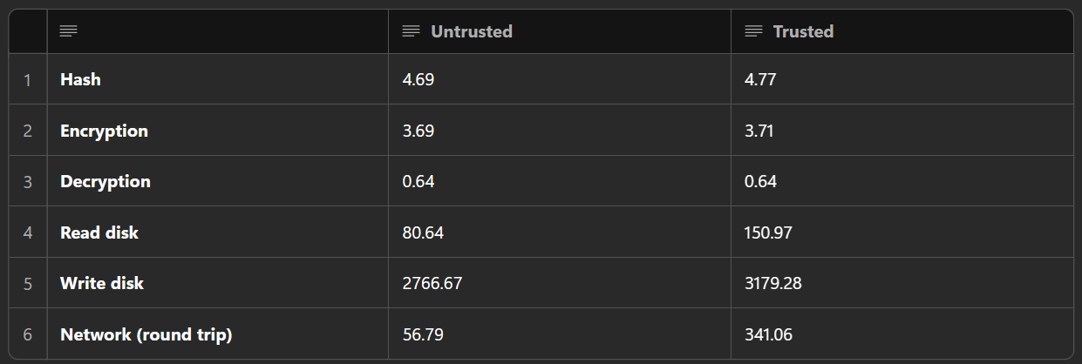


Microbenchmarks (50th percentile, microseconds)
Should be much faster to network than to write to disk
VMs: Standard_D8as_v5 or Standard_DC8as_v5 AMD's 3rd Generation EPYCTM 7763v processor

Slide 19
Local demo

Slide 20
Planned evaluations
TPC-C on Postgres, regular vs Rollbaccine
Can turn off replication, tmpfs, FUSE, etc to measure what % of latency each takes up
How many cores? How large should TPC-C be? How many Gbs should tmpfs be allocated with?
NNThroughputBenchmark on HDFS, regular vs Nimble vs Rollbaccine
Nimble only runs it with 2 nodes (1 namenode and 1 datanode)
Raft?
Anything that uses disk?

Slide 21
Technical questions
Using CCF to manage config
What should the attestation process look like?
Zero-copy messaging
How can we broadcast writes efficiently?
Current process: FUSE receives a buffer of data.
The client copies the buffer into a vector of bytes (1 copy), serializes it (2 copies), then broadcasts it.
Replicas read into a buffer, deserialize it (1 copy), then writes it locally (2 copies).
Can experiment with sendFile()?
Gossip vs leader broadcast
Should the client broadcast writes, or send the write to a random node to offload broadcasting?
How expensive is broadcasting vs sending to a single node?

